Slide 1
Taking Responsibility, Being Accountable and Communication

Slide 2
Case Study –Accountability/ Responsibility
Background of the case:
Milo, John, and Cindy are good friends and they are graduating this semester. They are working on a group project for their chemistry class taught by Professor Glass. Their project consists of three parts: theoretical background, a chemical experiment and a comparative analysis of their results. At the end of two weeks, each group is expected to turn-in the final report summarizing their work. Professor Glass mentioned that each report should include the contribution of the three members in terms of percentage. Milo, John and Cindy decided to split the work. Milo is responsible for preparing the theoretical background. John agreed to do the experimental work. Cindy decided to take care of the comparative analysis after Milo and John complete their parts. The duration for this project is two weeks. So, Milo and John decided to work on their individual tasks during the first week. Since Cindy decided to work on the analysis of their work, she wanted to work on her part during the second week. John agreed to submit the final report after Cindy sends him her part of the project.

Slide 3
Data of the case:
John spent his time mostly in the lab conducting the experiment and completed his part of the project within the first week and sent his results to Cindy. During this week, he met the teaching assistant for Professor Glass three times during his office hours to clarify some questions related to the experiment. Milo started visiting the library to work on the theoretical part. However, he spent most of his time chatting with his girl friend who happened to work in the same library. At the end of the week, he was able to complete half of the literature survey that the group wanted to complete. Both Milo and John sent their reports to each other and copied to Cindy as well. Cindy has all the material she needed to complete her analysis. However, she was sick during the whole week and could not spend any time on this project. On the last day, the group discussed the project and decided to submit whatever they had done. John submitted the report indicating that all three of them contributed equally for the project.
Professor Glass and his teaching assistant came up with the following grading policy. Each portion of the project will be graded for one hundred points for a total of three hundred. The three students who worked on the project will share total points according to the percentage of they put in. (Assuming that everyone in the group contributed equally to the project, each student will get one-third of the total score, which is equal to one hundred points.) Milo, John and Cindy received a total of 150 points (50 points for the theory, 100 points for the experimental part and 0 for the analysis). Since, the report mentioned that all three contributed equally, Milo, John and Cindy received 50 points each, which is the minimum, score for this project. If Milo, John and Cindy keep quiet, all three of them will pass the course and will be able to graduate this semester

Slide 4
Questions
1- John maintained a 4.0 GPA during all the previous semesters and if he receives 100 points in this course, he will not only keep his GPA but also receive an award from the college for his overall performance. A score of 50 points will reduce his GPA and he will lose the award. However, John likes his friends and he doesn't like the consequences his friends may encounter if he reveals the truth. What are his options?Milo is aware that he received the score that he deserved as per his contribution. Cindy could graduate this semester if everyone keeps silent. However, she is aware that John would be the loser. What are the options for the group?

Slide 5
2- The teaching assistant talked to the three students to find out what exactly happened. What should be his advise to the students? Should he inform Professor Glass? What are his options?
3- Professor Glass was surprised to see the poor performance of the group. He is aware that John is expected to receive the award. Assuming that the teaching assistant informed him what he knew, what are the Professor's options?

Slide 6
Need to know…
Responsibility/ Accountability is more of a leadership problem then an employee problem.
Responsibility/ Accountability is usually viewed as something negative that happens when things go wrong or as a punishment for mistakes.
Whenever people blame other people, places and things; you have an accountability problem.
Blame inhibits corrective action and undermines learning.
Negative accountability never works over the long term.
Responsibility/ Accountability should be viewed as a powerful, positive and enabling principle that provides the foundation to build both individual and company success.
It is only when you build a culture of positive accountability that you have people who can and will achieve game-changing results.

Slide 7
Accountability v/s Responsibility
By having a sense of responsibility, you can reflect on the outcomes of your work and develop a strategy to avoid making future mistakes.
Additionally, taking responsibility gives you an opportunity to build relationships that are based on trust.
When you have a sense of responsibility, it means you are willing to accept and live by society’s established standards of individual behavior.
When these expected standards aren’t met, someone with responsibility doesn’t seek others to blame, rather they’re able to maturely respond to the presented challenges themselves and take any blame for their actions.
More simply put, your life is full of choices, and what you do with them governs your whole reality.
Being able to see that your decisions have a direct impact on your life’s events is what being able to accept responsibility is all about.
It doesn’t matter where you fall on the spectrum of the simplicity of your life, you are able to see that you create both the good and the bad circumstances.

Slide 8
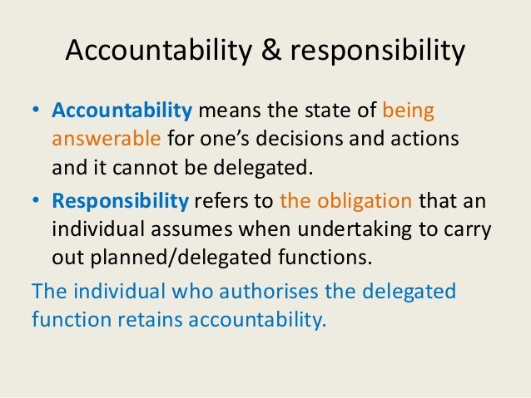

Slide 9
Meaning of Accountability
The obligation of an individual or organization to account for its activities, accept responsibility for them, and to disclose the results in a transparent manner. It also includes the responsibility for money or other entrusted property.
Clarifying and aligning roles ensuring that the right people are doing the right work.
Defining, communicating and describing expectations so that all employees know what excellence looks like in terms of performance and behaviors.
Recognizing great effort and work, including excellence in teaming and collaboration

Slide 10
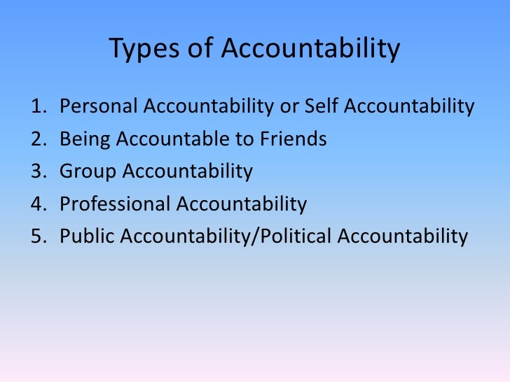

Slide 11
Signs of Not Being Responsible
Lacking interest in their work, and in the well-being of the team.
Blaming others for mistakes and failures.
Missing deadlines.
Avoiding challenging tasks and projects, and not taking risks.
Regularly complaining about unfair treatment by team leaders and team members – and engaging in self-pity.
Avoiding taking initiative, and being dependent on others for work, advice, and instructions.
Lacking trust in team members and leaders.
Making excuses regularly – they may often say "It's not my fault," or, "That's unfair."

Slide 12
Importance at Workplace
Improved work performance
Increased participation and involvement
Feeling more competent
Higher commitment to work
Higher creativity and innovation
Higher morale and satisfaction.

Slide 13
Obstacles
Measurements: Sometimes what’s easy to measure isn’t important to measure. Many people confuse correlation with causality putting too much faith in the numbers.
Fear of failure: You must allow for mistakes and adjustments. When failure is punished, people stop trying.
Distress over lack of control: When people don’t trust others in the organization, they won’t participate in an accountability plan that depends on others.
Lack of commitment on both sides: When the request isn’t important enough to go to the top of the priority list or they don’t follow through.
Uncertainty of Consequences: It’s difficult to accept responsibility for something when the outcome is less certain to predict.
Results: If you focus only on results, it’s easy for people to achieve the end by any means necessary. This opens the door to ethical, reputational, legal and safety obstacles.

Slide 14
Ways to Encourage Responsibility and Accountability
Define specific goals and get a commitment
Provide updates on progress
Hold yourself accountable
Use the 5Cs framework to build accountability
- Common purpose: Connect with your team by helping them understand why you need them to do a particular task. Rather than just telling your team what to do, rally around a common goal explaining what the point is and why it matters.
- Clear expectations: Let your team know what they need to do with clear expectations. Collaborate with your team to establish what success looks like and make sure they understand what you expect from them.
Communicate and align: Keep your team rowing in the same direction, focused and aligned. Communicate over and over with your team, asking questions and reminding them that their work is important.
- Collaborate and coach: Monitor your teams progress regularly to adjust in real time. Coach your team by listening to their concerns – don’t just tell them what to do. Your job is to be a resource of support to them.
- Consequences: Consequences are often a result of the things that go wrong, but consequences can also be positive. Display visible results for your staff, learn from mistakes and make recognition immediate when things go well.

Slide 15
Qualities of having Responsibility
Strong Communication Skills
Ability to Create Boundaries
Humility
Ability to Control Impulses
Being Courageous
Being Persistent
Being Authentic
Being Organized

Slide 16
Positive Feedback
Positive reinforcement is a powerful source of fuel that energizes people to try harder, persist longer and overcome difficulties.
When we receive praise, our brain releases dopamine, a neurotransmitter that stimulates the pleasure centers.
Gallup Survey shows that individuals who receive regular recognition and praise:
Increase their individual productivity.
Increase engagement among their colleagues.
Are more likely to stay with an organization.
Receive higher loyalty and satisfaction scores from customers.
Have better safety records and fewer accidents on the job.
Nothing has greater impact on an employee than when recognition comes from their direct supervisor.

Slide 17
How to Give Feedback
Ask for permission to give feedback.
“Hey, do you have a minute for some quick feedback?”
State what you observed.
“After work yesterday, I noticed that you didn’t help the rest of the crew do clean-up.”
Don’t say: “After work yesterday, I noticed you were being lazy.”
Explain the impact.
“When you explained our return policy to the customer it looked like she became more irate.”
Don’t say: “I noticed you pissed off the customer.”
Pause and ask for the other person’s reaction.
Suggest concrete next steps. Give one or two actionable suggestions that the other person can take in the future to improve this outcome.

Slide 18
Summing up
Adopt traits of a good leader to promote employee empowerment. To empower your employees, you have to be a role model.
Delegate tasks clearly and concisely. Make sure there are no gray areas when assigning specific duties to specific employees. That way, employees will know exactly what is expected and there will be no room for passing the buck.
Give up some of your power in favor of employee autonomy. This makes their work feel more exciting and rewarding, since they’ll feel like they have more of a say in the work they do.
Be friendly without being a friend. Though you should avoid being that “cool boss” who is too friendly with all of his employees, it doesn’t hurt to smile at your employees, make small talk to show you care about them on an individual basis.
Be respectful. To motivate employees, you have to respect them as human beings and employees.
Be positive. To be a good leader, motivate your employees with a positive attitude and environment.
Acknowledge employee achievements. Make it a point to frequently cite successes and to verbally congratulate employees on a job well done.
Open your door to employees. An important part of empowering employees is letting them know their opinions are valuable.

Slide 19
Summing up…
Give more compliments than criticism. Though criticism is helpful if given correctly, you should focus on all of the good things that your employees are doing instead of nitpicking them and making them feel like “no news is good news.”
Criticize constructively. You can’t succeed in your job if you never criticize your employees, but when you explain something they’ve done incorrectly, make sure you do so in a respectful manner.
Understand what motivates each employee. To empower employees, know what makes them tick. They won’t all be motivated by the same thing, so if you want them to succeed, you have to know their strengths and weaknesses to make the most of their abilities.
Make employees feel like they are part of the company. To empower employees, you have to make them feel like what they do for the company really does matter and impacts its success.
Show employees there’s room for growth in the company. To empower employees, make sure they have a clear path to success and that they feel recognized as they get better and better at their jobs.
Be willing to do what you ask them to do. Then stand “shoulder to shoulder” with them assisting them with the task; this helps to build your respect as a leader.
Make the workplace a welcoming environment. Another way to empower your employees is to make your workplace a fun and friendly place to work.

Slide 20
Communication
Derived from the Latin terms Communis or ‘Communicare’ means common or to impart or to share
Refers to the reciprocal exchange of information, ideas, facts, opinions, beliefs, feelings & attitudes through verbal or nonverbal means between two people or within a group of people.
Louis Allen –
“Communication is the sum of all things which a person does when he wants to create understanding in the mind of another. It involves a systematic and continuous process of telling, listening and understanding.”
Peter Little –
“Communication is the process by which information is transmitted between individuals and/or organization so that an understanding response results.”

Slide 21
W.H. Newman –
“ Communication is an exchange of facts, ideas, opinions or emotions by two or more persons.”
The American Management Association –
Communication is any behavior that results in an exchange of meaning.

Slide 22
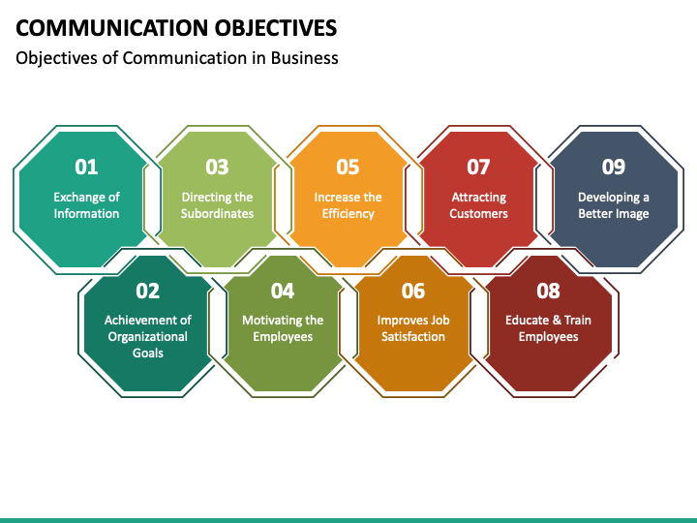
Objectives of Communication

Slide 23
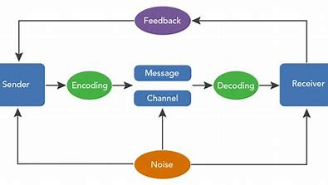
Process of Communication
The process of communication refers to the transmission or passage of information or message from the sender through a selected channel to the receiver overcoming barriers that affect its pace.
The process of communication is a cyclic one as it begins with the sender and ends with the sender in the form of feedback.

Slide 24
Types of Communication
On the basis of organization relationship
Formal
Informal
On the basis of Flow
Vertical
Horizontal
Crosswise/Diagonal
On the basis of Expression
Verbal
Non-verbal
Levels
Intrapersonal
Interpersonal
Mass Communication

Slide 25
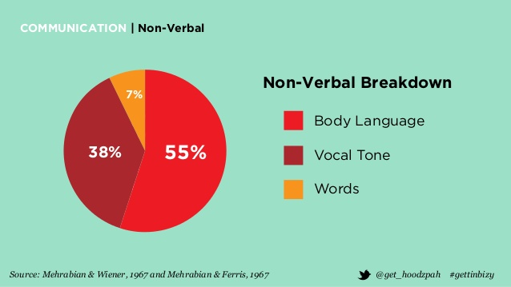
Non-verbal Communication
Eye Contact
Facial Expressions
Posture
Haptics or Touch
Gestures
Personal Space

Slide 26
Barriers to Communication
Language or Semantic
Psychological
Mechanical
Cross-cultural
Organizational

Slide 27
Overcoming Barriers
Taking the receiver more seriously
Crystal clear message
Delivering messages skillfully
Focusing on the receiver
Using multiple channels to communicate instead of relying on one channel
Ensuring appropriate feedback
Be aware of your own state of mind/emotions/attitude

Slide 28
Professionalism
In simple terms, professionalism means the conduct, behavior and attitude of someone in a work setting or business environment. It’s a component of work ethics that’s reflective of an individual’s consideration of others. It leads to lasting professional relationships, a strong professional reputation and workplace success.
Professionalism is usually perceived as a singular’s adherence to a bunch of norms, implicit rules, or an assortment of characteristics that portray acknowledged practice inside a specific space of action.
Professionalism at work is most important and is a key component for a successful career.

Slide 29
Key elements of professionalism
Appearance: Appearance helps companies project the right image with clients and the public. The air of confidence your appearance exudes makes people respect you more.
Behaviour and Attitude: Appropriate behavior on the job includes showing up for work on time, respecting your coworkers, suppliers and boss, and abiding by the company's policies and procedures. You must also be empathetic to people's needs.
Competence: Competence is being able to do your job effectively. Your educational background and experience dictate your competence on the job. Competence also entails a certain degree of autonomy and self-direction.

Slide 30
Accountability: Professionalism also includes holding yourself accountable for your words and actions, especially when you have made a mistake.
Integrity: Integrity is a large part of professionalism. Honesty and Dependability are two traits that are expected in most workplace situations. Without responsible behavior, distrust can make a work environment tense and uncomfortable. Polite communication, respectable behavior and fiscal responsibility also help you stand out as a trustworthy employee.

